Slide 1

Credit Score Rating Simulator
Kevin Rivera
Notes:
Hello everyone thank you for joining me today my name is Kevin Rivera and today i’ll be presenting my Credit Score Rating Simulator.

Slide 2

Table of Contents
Business Problem
Data
Modeling Evaluation
Demonstration
Next Steps
Notes:
In this presentation we will be going over the
business problem
an overview of the data used
our modeling evaluation
a quick demonstration of the deployed model
and the next steps on further improving the model

Slide 3
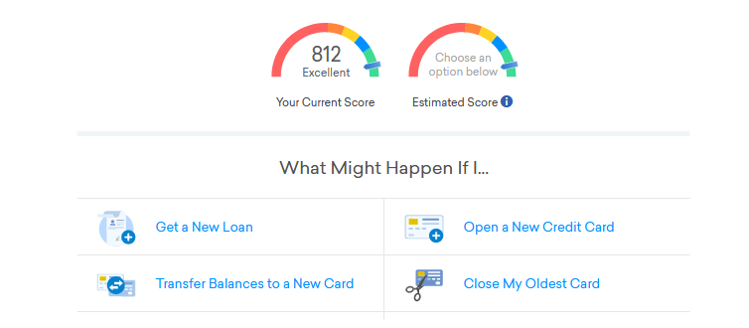
Business Problem
Notes:
Often people are unsure what affects credit score as it is something that is not widely known.
Credit Karma was a pioneer in paving the way to give users insight on the different factors that can affect a person's credit score
As of today credit karma has a very basic simulator tool that can show a person how their credit score can change based on a couple different features.
The goal of this model was to bring a much more in depth tool to provide users a wide range on possibilities on how user can improve their credit rating

Slide 4

Data
Kaggle
45,000 records
13 features
Notes:
The data we used for the model was from kaggle. It includes 45,000 records and has 13 features.

Slide 5

Model Evaluation
Accuracy 73%
Category | Credit Score | Ex Car New Loan Int
Poor | 300 - 579 | 9.75%
Standard | 580 - 669 | 6.57%
Good | 670 - 739 | 4.03%
Notes:
The specific model used was an XGBoost Classifier and it produced an accuracy of 73% on unseen data.
Our model predicts the users credit rating into 3 different categories
Poor
Standard
Good
In the table shown you can see the credit score ranges associated with each category and an example of what kind of interest rate you would receive on a new car loan

Slide 6
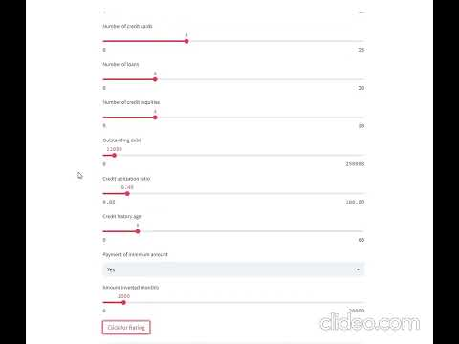
Demonstration
Notes:
Here we have a short clip on how the app works
Simply put in all the corresponding inputs and click the button for your rating.
Now let's say you took out a loan for some remodeling of the house and tackled on a little more debt.
The model will simulate what kind of affect that could have on your credit rating even tweaking certain features.

Slide 7
Next Steps
Gathering more data with the help of credit karma’s database
Creating an exact score model
Adding a helper box in the app
Notes:
For the next steps I would like to gather more data with the help of credit karmas database
Possibly create a similar model that would predict a users exact credit score
Add a helper box for the features users are unfamiliar with based on feedback from the users

Slide 8
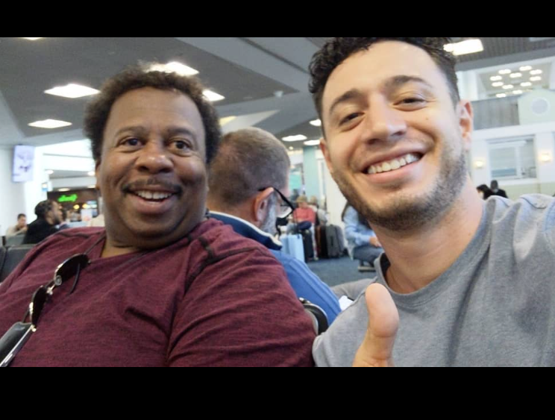



Questions?
KEVIN RIVERA
Notes:
That concludes my presentation
Stanley and I would love to answer any questions you may have?

